Slide 1
Fair use notice
The material used in this presentation i.e., pictures/graphs/text, etc. is solely intended for educational/teaching purpose, offered free of cost to the students for use under special circumstances of Online Education due to COVID-19 Lockdown situation and may include copyrighted material - the use of which may not have been specifically authorized by Copyright Owners. It’s application constitutes Fair Use of any such copyrighted material as provided in globally accepted law of many countries. The contents of presentations are intended only for the attendees of the class being conducted by the presenter.

Slide 2
OBJECT ORIENTED PROGRAMMING
Presented by: Engr. Mariam Memon

Slide 3

Table of contents
Operators in Java
Arithmetic operators
Bitwise operators
Relational Operators
Logical Operators
Operator Precedence

Slide 4
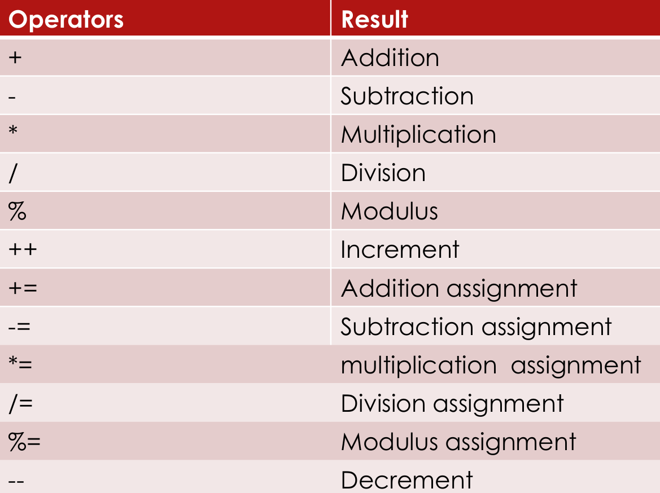
Arithmetic operators

Slide 5
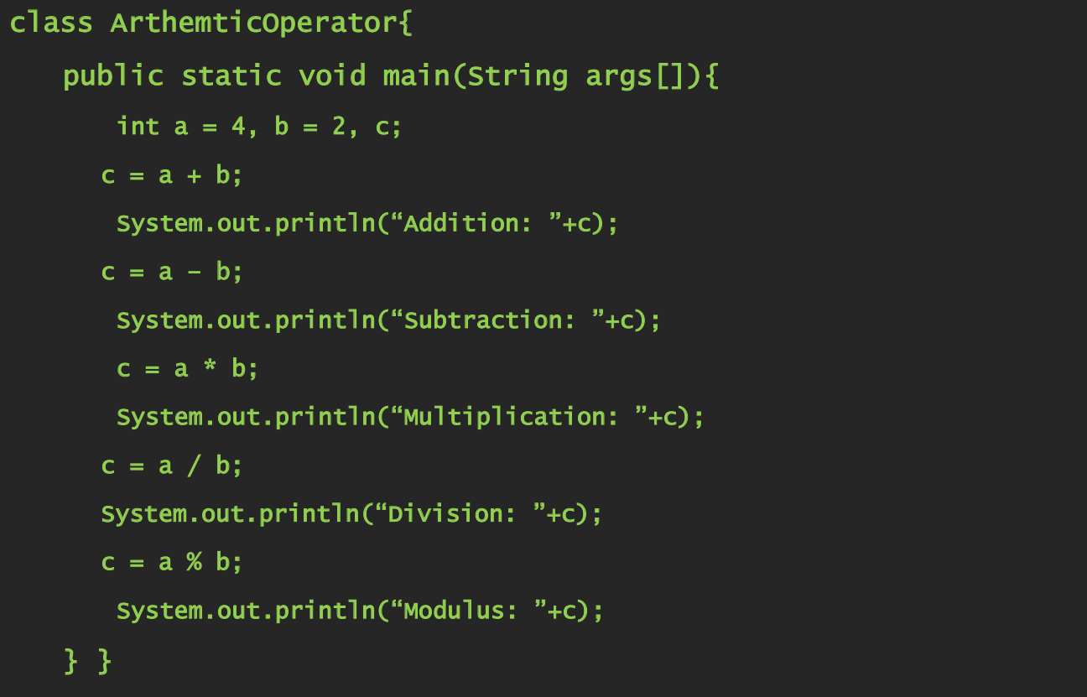
example

Slide 6
Arithmetic operators contd.
Arithmetic Assignment Operators:
+= -= /= *=
For Example:
a +=2 a = a + 2
a -= 2 a = a –2
a /= 2 a = a / 2
a *= 2 a = a * 2

Slide 7
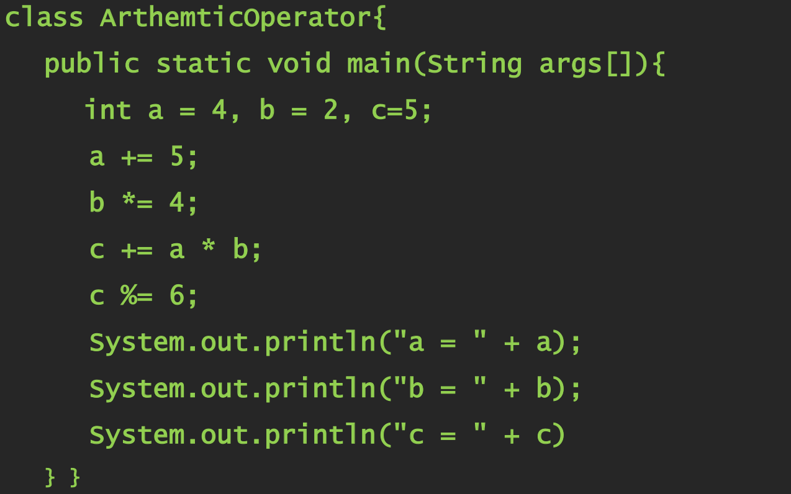
example

Slide 8
Arithmetic operators contd.
The increment operator is written as two plus signs (++) and add 1 to the value.
The decrement operator (--) is similar, except that it subtracts 1 rather than adds 1 to the value of the variable.
Postfix form num++; num--;
Prefix form ++num; --num;

Slide 9
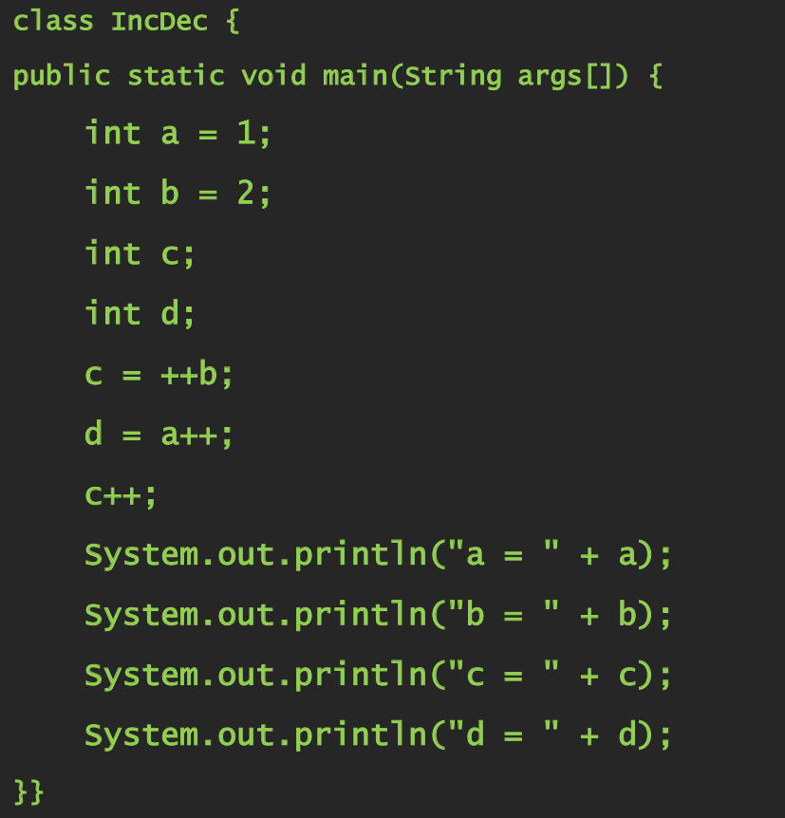
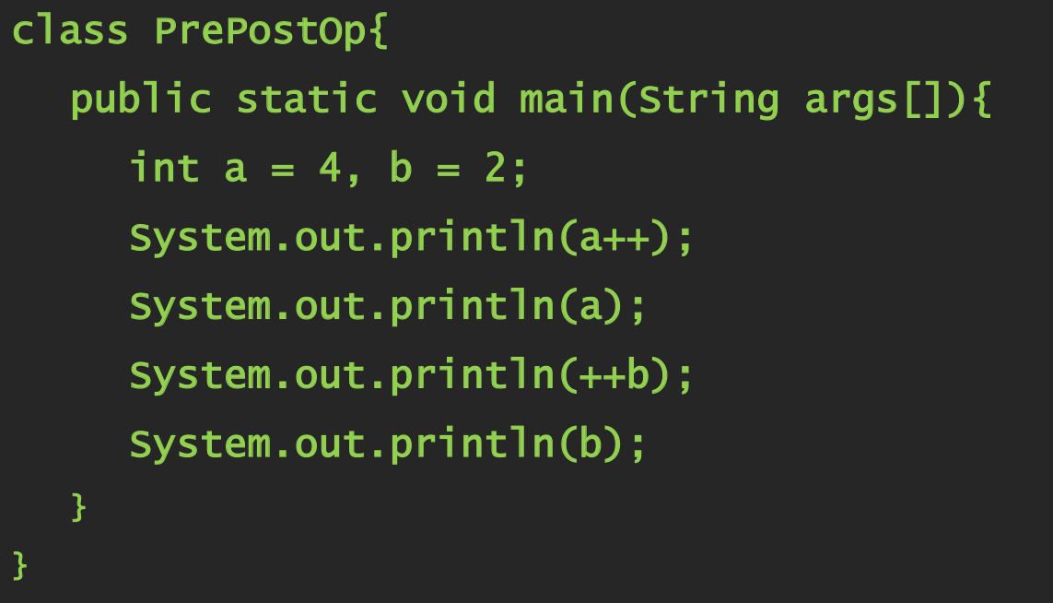
Example Programs

Slide 10
Bitwise operators
Bitwise operators can be applied to the integer types, long, int, short, char, and byte.
Manipulate the bits within an integer
All the integer types are represented by binary numbers of varying bit widths
They can represent negative values(as two’s compliment) as well as positive ones.

Slide 11
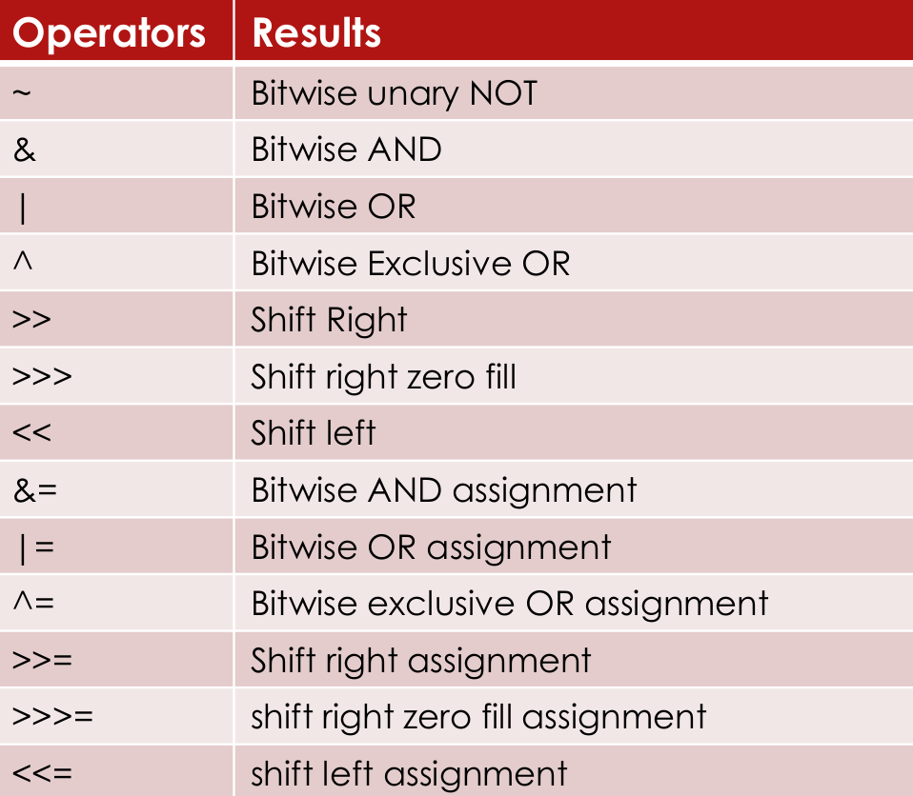
Bitwise operators

Slide 12
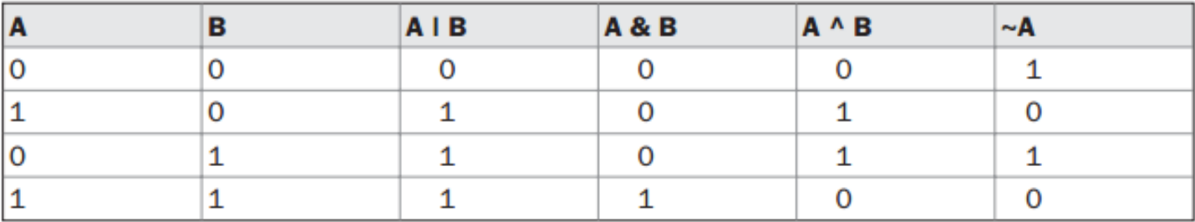
Bitwise operators
The Bitwise Logical Operators
& | ^ ~

Slide 13
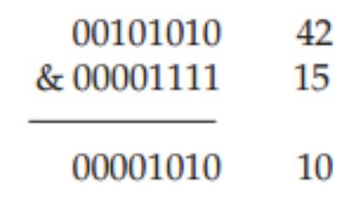
Bitwise operators
The Bitwise NOT
Number 42 in binary is 00101010
After Bitwise NOT operation the value is 11010101
The Bitwise AND

Slide 14
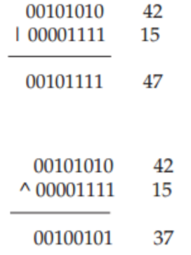
Bitwise operators
The Bitwise OR
The Bitwise XOR

Slide 15
Bitwise operators
The shift left operator
value << num
The<< moves all the bits in the specified value to the left by the number of bit positions specified by num.

Slide 16
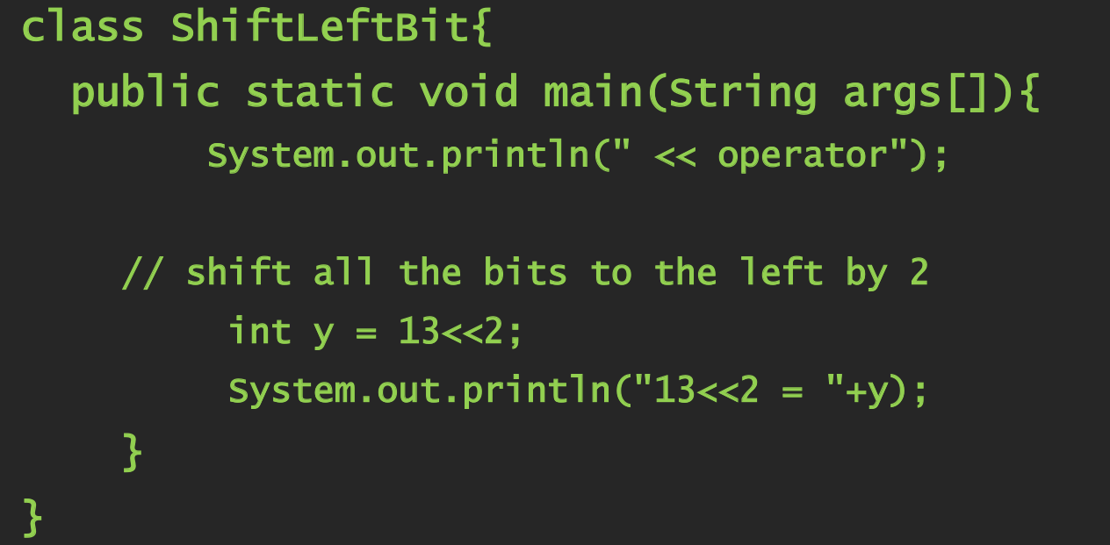
Example Program

Slide 17
Bitwise operators
13<<2 = 52
13 in binary is
00000000000000000000000000001101
shift left 2 positions and fill right bits with 0s, you obtain:
00000000000000000000000000110100

Slide 18
Bitwise operators
The right shift operator
value >> num
The >> moves all the bits in the specified value to the right by the number of bit positions specified by num.

Slide 19
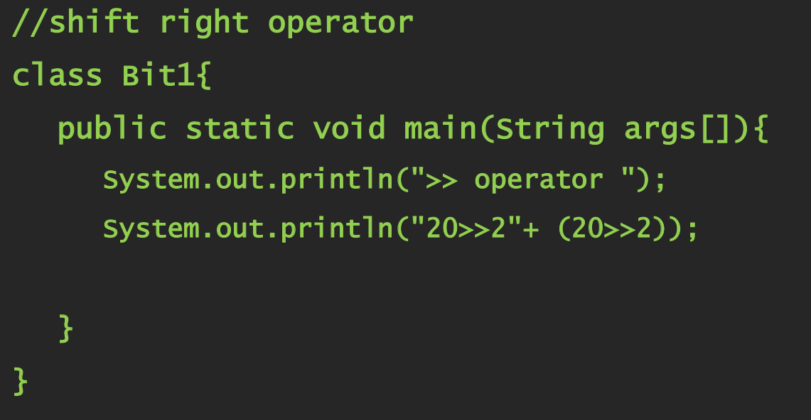
Example Program

Slide 20
Bitwise operators
Explanation of 20>>2 = 5
20 in binary is:
00000000000000000000000000010100
shift all bits 2 positions to right
00000000000000000000000000000101

Slide 21
Bitwise operators
Explanations of -1>>2 = -1
-1 in binary is:
11111111111111111111111111111111
shift all bits 2 positions to the right AND insert 1's to left you obtain
11111111111111111111111111111111

Slide 22
Bitwise operators
The Unsigned Right Shift
>> operator automatically fills the high-order bit with its previous contents each time a shift occurs.
This is undesirable sometimes therefore, >>> is used.
int a = -1;
a = a >>> 24;
11111111 11111111 11111111 11111111 –1 in binary as an int
>>>24 00000000 00000000 00000000 11111111 255 in binary as an int

Slide 23
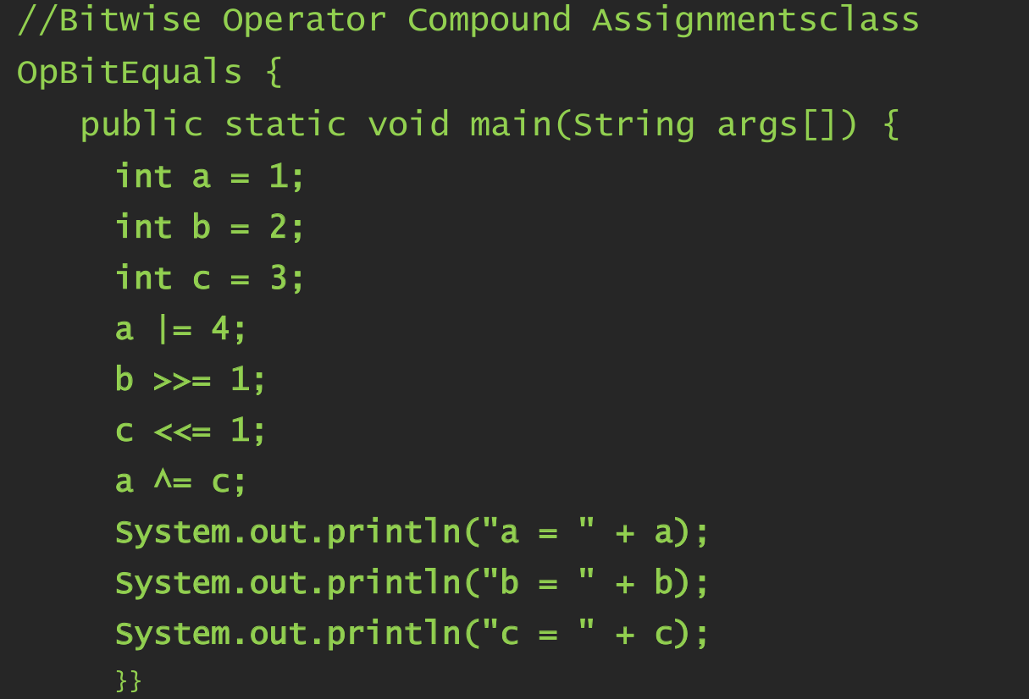
Example program

Slide 24
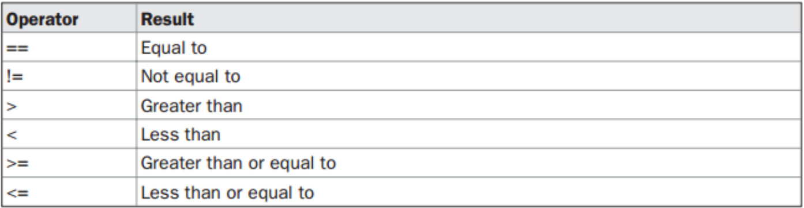
Reational operators
The outcome of these operations is a Boolean value.
The relational operators are most frequently used in the expressions that control the if statement and the various loop statements.

Slide 25
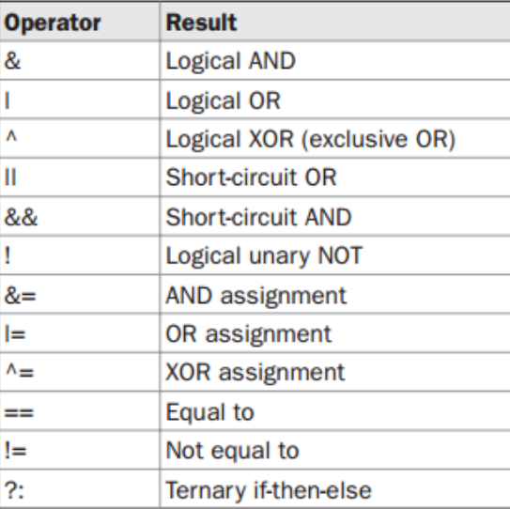
Boolean logical operators
The Boolean logical operators operate only on boolean operands.
All the binary logical operators combine two boolean values to form a resultant Boolean value.

Slide 26
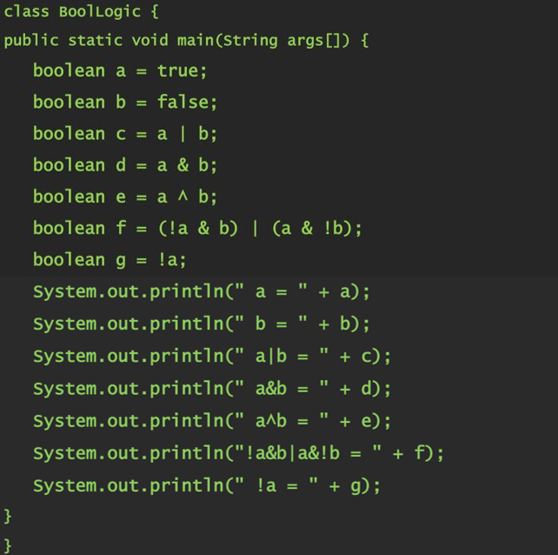
Example program

Slide 27
Reational operators
Short-Circuit Logical Operators
|| the OR operator results in true when A is true, no matter what B is
&& the AND operator results in false when A is false, no matter what B is.
This is very useful when the right-hand operand depends on the value of the left one in order to function properly.
if (denom != 0 && num / denom > 10) //short circuit AND

Slide 28
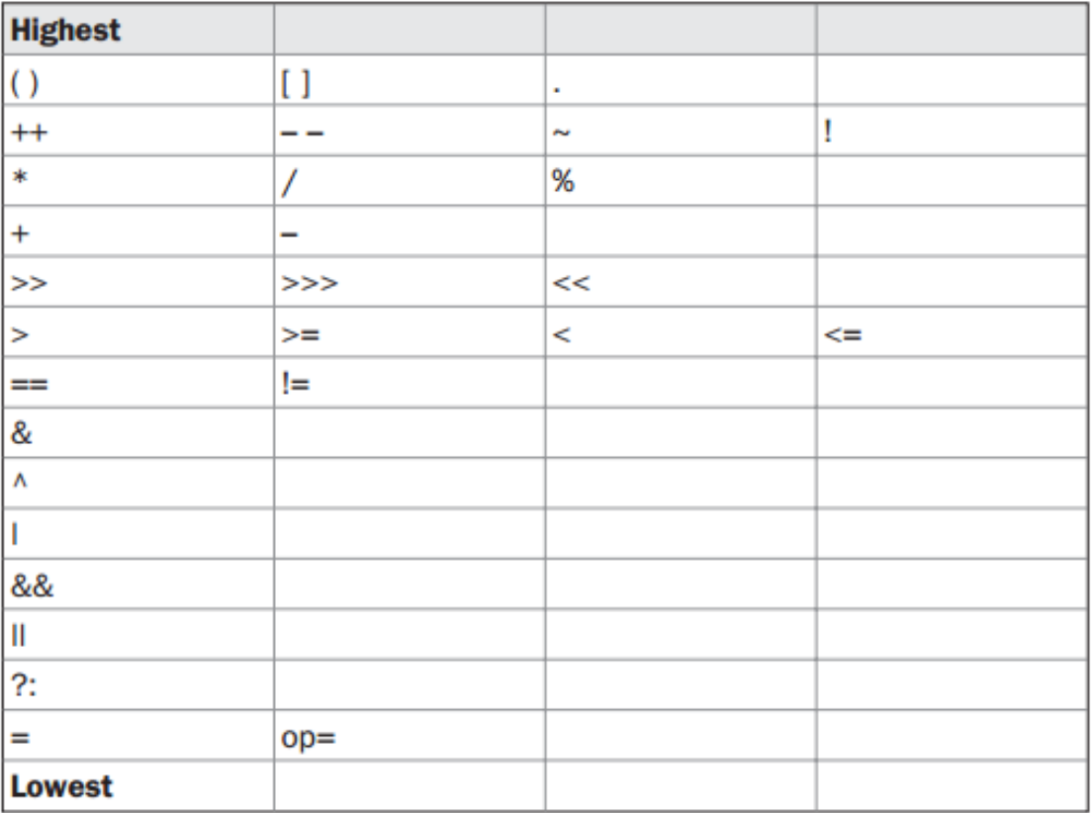
Operator precedence

Slide 29
THANK YOU!

